Slide 1

PARALLEL & DISTRIBUTED DATABASES
By: Dr. Devpriya Soni
Department of Computer Science and Engineering & IT
Jaypee Institute of Information Technology, Noida
Notes:
Frequently, presenters must deliver material of a technical nature to an audience unfamiliar with the topic or vocabulary. The material may be complex or heavy with detail. To present technical material effectively, use the following guidelines from Dale Carnegie Training®.
Consider the amount of time available and prepare to organize your material. Narrow your topic. Divide your presentation into clear segments. Follow a logical progression. Maintain your focus throughout. Close the presentation with a summary, repetition of the key steps, or a logical conclusion.
Keep your audience in mind at all times. For example, be sure data is clear and information is relevant. Keep the level of detail and vocabulary appropriate for the audience. Use visuals to support key points or steps. Keep alert to the needs of your listeners, and you will have a more receptive audience.

Slide 2
Lecture will cover following points
INTRODUCTION
WHY DISTRIBUTED DATABASES
PARALLEL VS. DISTRIBUTED DATABASES
WHY PARALLEL PROCESSING
DIFFERENT ARCHITECTURE

Slide 3
INTRODUCTION
In centralized database:
Data is located in one place (one server)
All DBMS functionalities are done by that server
Enforcing ACID properties of transactions
Concurrency control, recovery mechanisms
Answering queries
In Distributed databases:
Data is stored in multiple places (each is running a DBMS)
New notion of distributed transactions
DBMS functionalities are now distributed over many machines
Revisit how these functionalities work in distributed environment

Slide 4
WHY DISTRIBUTED DATABASES
Data is too large
Applications are by nature distributed
Bank with many branches
Chain of retail stores with many locations
Library with many branches
Get benefit of distributed and parallel processing
Faster response time for queries

Slide 5
PARALLEL VS. DISTRIBUTED DATABASES
Distributed processing usually imply parallel processing (not vise versa)
Can have parallel processing on a single machine
Assumptions about architecture
• Parallel Databases
Machines are physically close to each other, e.g., same server room
Machines connects with dedicated high-speed LANs and switches
Communication cost is assumed to be small
Can shared-memory, shared-disk, or shared-nothing architecture
• Distributed Databases
Machines can far from each other, e.g., in different continent
Can be connected using public-purpose network, e.g., Internet
Communication cost and problems cannot be ignored
Usually shared-nothing architecture
Content Sources: -Elamsari and Navathe, Fundamentals of Database Management systems, -Silberschatz−Korth−Sudarshan • Database System Concepts, Fourth Edition

Slide 6
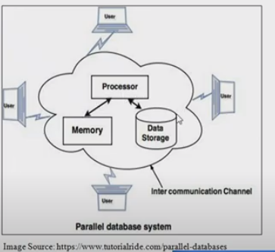
PARALLEL DATABASES
Machines are physically close to each other (e.g. same server room).
Multiple Processor are handling database.
Database is shared and partitioned in disk.

Slide 7
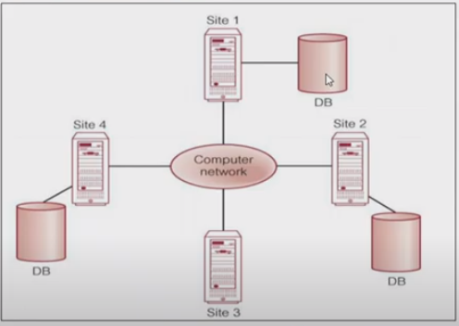
DISTRIBUTED DATABASES
Data is physically stored across several sites.
Each site is managed by an independent database.

Slide 8
PARALLEL DATABASE
&
DISTRIBUTED DATABASES

Slide 9
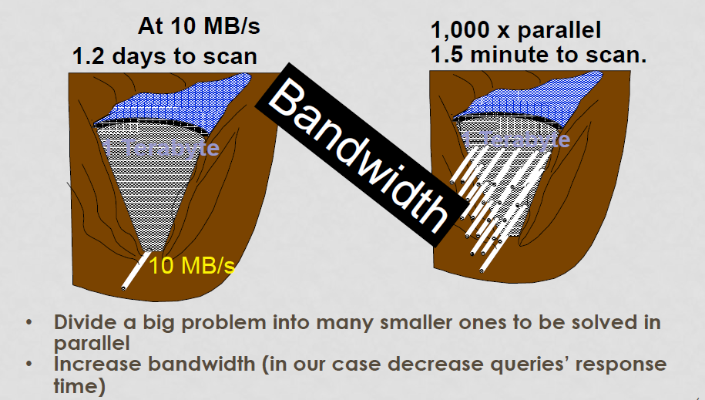
WHY PARALLEL PROCESSING

Slide 10
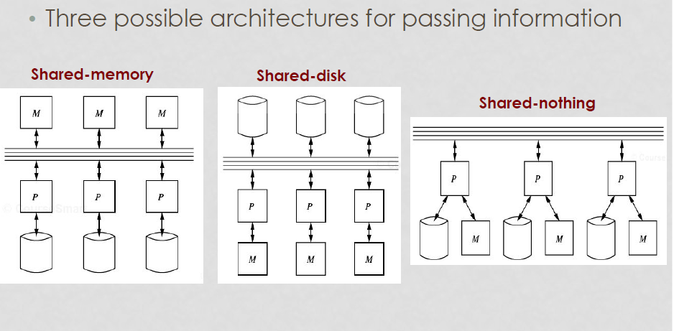
DIFFERENT ARCHITECTURE
Content Sources: -Elamsari and Navathe, Fundamentals of Database Management systems, -Silberschatz−Korth−Sudarshan • Database System Concepts, Fourth Edition

Slide 11
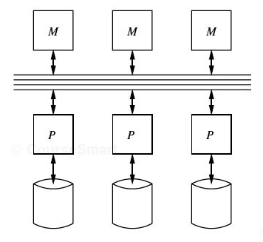
1- SHARED-MEMORY ARCHITECTURE
Every processor has its own disk
Single memory address-space for all processors
•Reading or writing to far memory can be slightly more expensive
Every processor can have its own local memory and cache as well

Slide 12
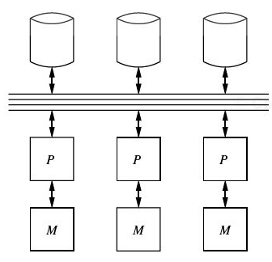
2- SHARED-DISK ARCHITECTURE
Every processor has its own memory (not accessible by others)
All machines can access all disks in the system
Number of disks does not necessarily match the number of
processors

Slide 13
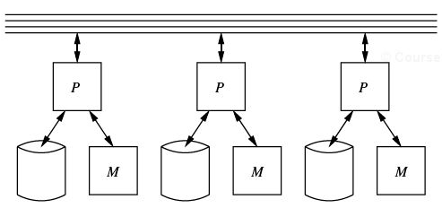
3- SHARED-NOTHING ARCHITECTURE
• Most common architecture nowadays
• Every machine has its own memory and disk
Many cheap machines (commodity hardware)
• Communication is done through high speed
network and switches
• Usually machines can have a hierarchy
Machines on same rack
Then racks are connected
• Scales better
• Easier to build
• Cheaper cost

Slide 14
Comparison Factor in Parallel and Distributed Database
Comparison Factor | Parallel Database | Distributed Database
System Components | In parallel databases, processes are tightly coupled and constitutes a single database system i.e., the parallel database is a centralized database and data reside in a single location | In distributed databases, the sites are loosely coupled and share no physical components i.e., distributed database is our geographically departed, and data are distributed at several locations
Component Role | Work independently to handle local transactions or work together to handle global transactions | Work together to handle global transactions

Slide 15
Comparison Factor | Parallel Database | Distributed Database
Designed for | Sharing Data Local Autonomy High Availability | High Performance Increased Throughput
Data Distribution | Uses Various data partitioning technique s | Uses Horizontal and Vertical Fragmentation

Slide 16
Comparison Factor | Parallel Database | Distributed Database
Objective | Improving performance and throughput | Providing high availability of data with reliability
Speed of execution | High | Low
Geographic Location | Located at same location | Located at different sites (remote)

Slide 17
Comparison Factor | Parallel Database | Distributed Database
Node types | Homogeneous | Heterogeneous and Homogeneous both
Expansion scope | Difficult to expand | Easy to expand
Overhead | Low | High

Slide 18
Comparison Factor | Parallel Database | Distributed Database
Performance | Lower reliability & availability | Higher reliability & availability
Backup | At one site only | At multiple sites
Maintaining consistency | Easier | Difficult

Slide 19
Thankyou

